Slide 1
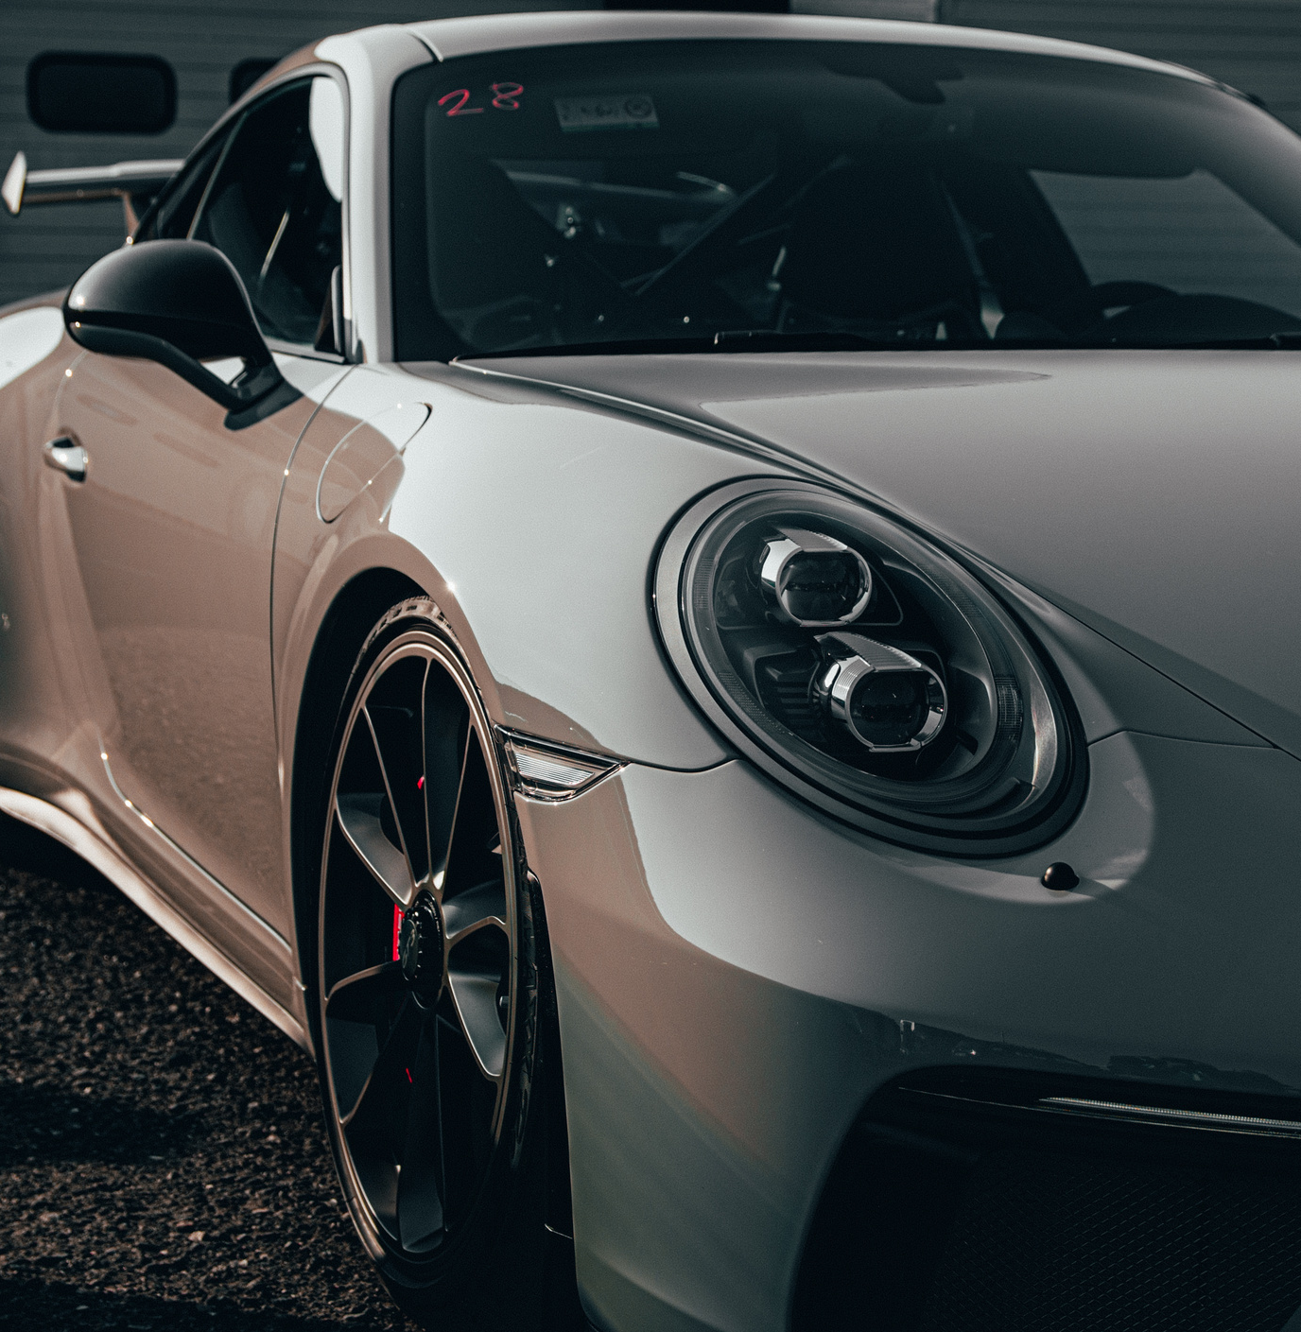



CRASH
LENS
THE FUTURE ON WHEELS
MARIA PRATYUSHA

Slide 2
